Slide 1
Welcome Back – Part 1
Jerusalem Is Rebuilt
Ezra, Nehemiah, Esther, Haggai, Zechariah, Malachi

Slide 2
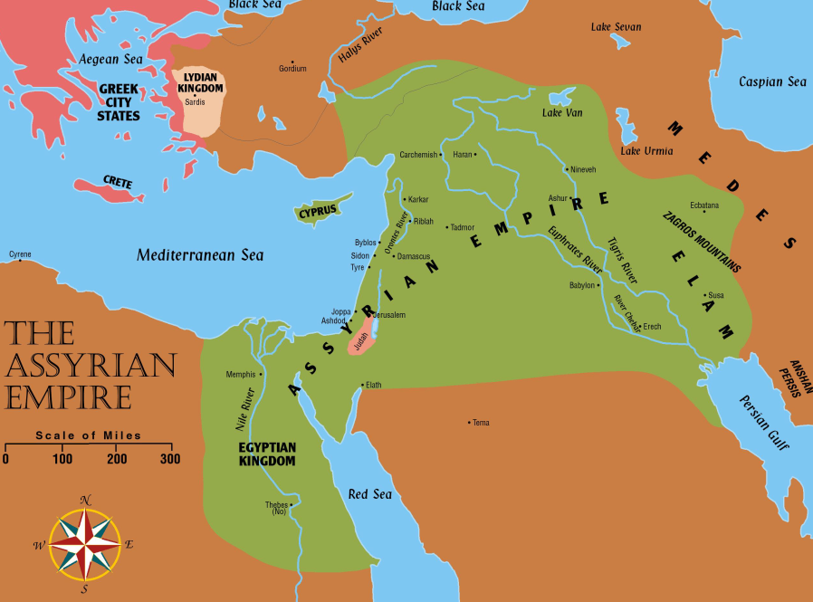
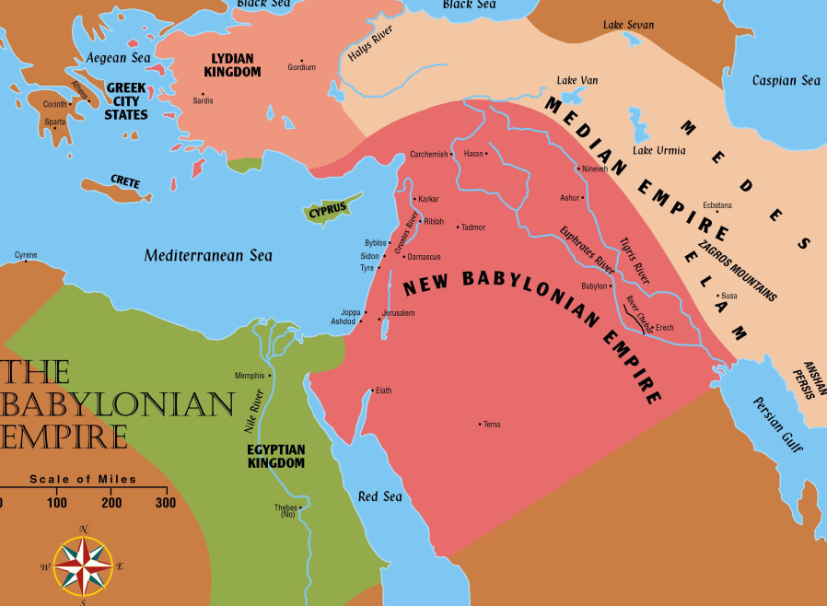
Jerusalem Is Rebuilt
Permission to go home included all the tribes of the Israelites. Ezra 1:3
  Israel (Northern tribes) was scattered throughout the Assyrian empire
  Judah (Southern tribes) scattered in Babylon

Slide 3
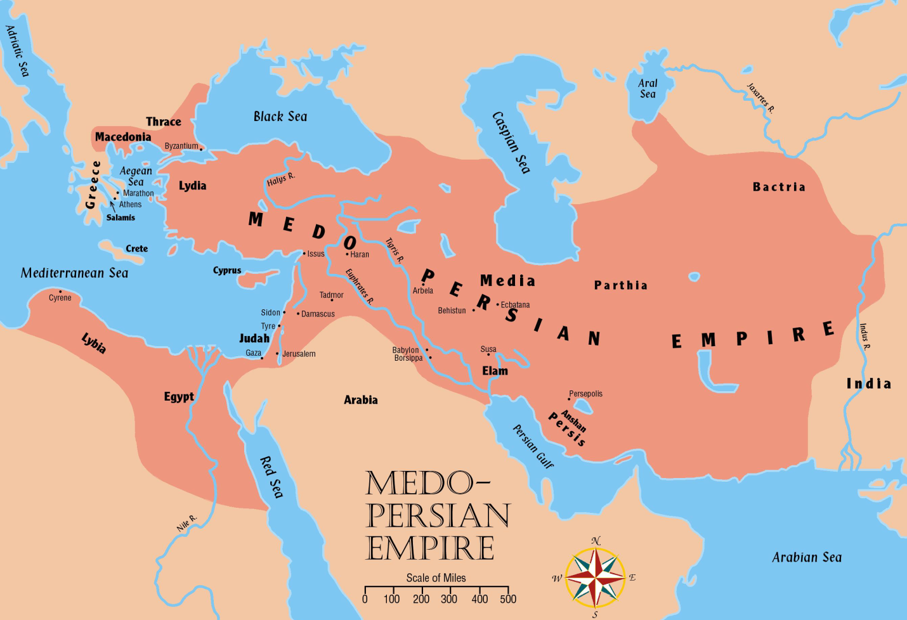
Jerusalem Is Rebuilt
Persia now controls all the territories once held by Assyrian and Babylonian empires

Slide 4
Captives Free to Return
536 B.C.
Many Israelites stayed where they were
  It has been almost 200 years since the first captives have been taken from Israel.
  721 BC
  The most recent captives have been gone 50 years
    They built homes and were content
    to stay
  It was their choice whether to return or not.
  Jews from various tribes mentioned in the NT (cf. Luke 2:36)

Slide 5
Captives Free to Return
536 B.C.
Approximately 50,000 Jews gathered in Babylon to start home (Ezra 2:64-65)
  Sheshbazzar (Ezra 1:8, 11; 5:14-15) and Zerubbabel (Ezra 2:2; 3:2,8; 4:3; 5:2) are named as leaders.
    Unknown whether these were two different men or two names for the same man

Slide 6
Captives Free to Return
536 B.C.
No “gods” to return to the Jews, WHY? However:
  Many valuable vessels taken from the temple and palace in Nebuchadnezzar’s day are returned.
  Ezra 2:68-69
    5,400 gold and silver vessels returned
  Jews who stayed behind helped their brethren with gifts to make their trip easier. Ezra 1
It was a day of great joy as they began
the trip
  However, the tasks ahead would not be easy

Slide 7
The People of Palestine
They profited from the Jews’ absence
  Samaritans had grown in power
    Claimed the territory around the ruins of Jerusalem
  Ammonites moved out of their near-desert territory into the fertile highlands of Gilead
  Edom moved out of the dry Negeb into
  land once belonging to Judah
    They took the city of Hebron
  Nomadic tribes moved nearer the
  fertile lands
    Established a more settled way of life

Slide 8
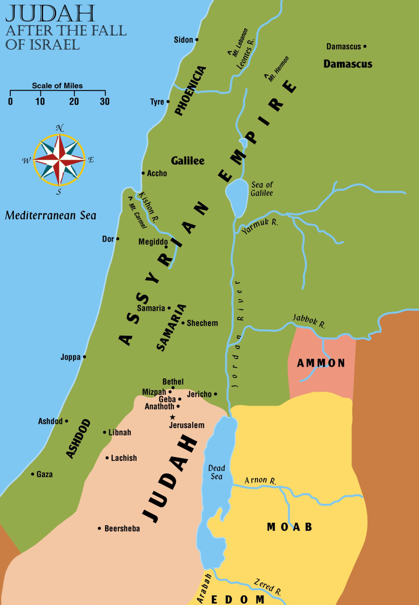
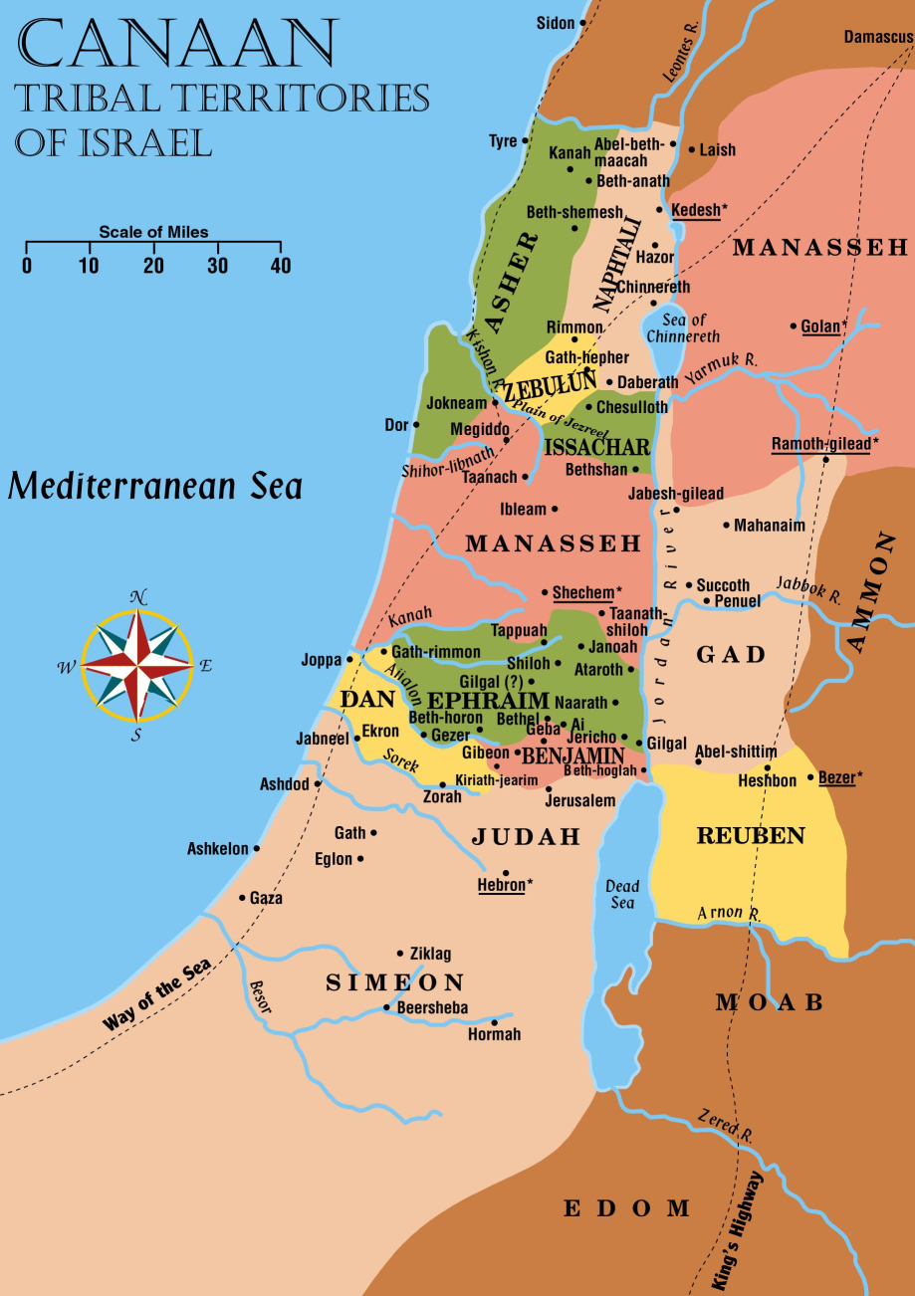
The People Of Palestine
Arab

Slide 9
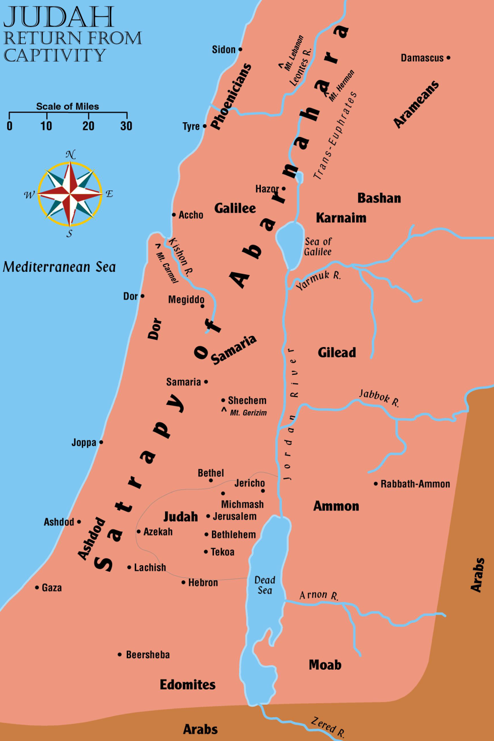
Judah
Return From
Captivity

Slide 10
Returns
3
The “three returns” in Ezra and Nehemiah:
  Jews return home under the leadership of Zerubbabel to build the temple. (Book of Haggai)
  Ezra returns with the Priests to start the spiritual reform.
  Nehemiah returns to build the walls. (Book of Nehemiah)

Slide 11
Return Number ONE
Jews return to Palestine under Zerubbabel.
Ezra 3
  Begin to work on their temple as soon as they reach Jerusalem
  Rebuilt the altar of burnt offering and began their regular sacrifices
    Celebrated when the foundations of the temple were laid.

Slide 12
Return Number ONE
  Praised God for His mercy
  Grief that day also
    Some present who could remember the splendor of the temple Nebuchadnezzar
    had burned
    This one would never compare to it!
    cf. Ezra 3:10ff; cf. Haggai 2:3

Slide 13
Return Number ONE
Adversaries began trying to stop their work
Samaritans desired to help build the temple. Ezra 4:1ff; Nehemiah 2:20
  Note who the Samaritans were and their understanding of God. 2 Kings 17:32

Slide 14
Return Number ONE
Adversaries began trying to stop their work. Nehemiah 2:17ff
  Wrote a letter to the new king Cambyses (Cyrus’ son) after Cyrus had died
    Called by the titles of Ahasuerus and Artaxerxes in the letter
  Accused the Jews of treason.
  Ezra 4:6ff; 11ff

Slide 15
Return Number ONE
  Asked the king to check the records to see if Jerusalem had not always been rebellious. Ezra 4:15
    Cambyses checked and he found that Jerusalem had been rebellious. Ezra 4:17ff
    As a result, he had the work stopped and nothing more was accomplished for 16 years. Ezra 4:21
    Yet the people built for themselves houses, yet did not prosper. Haggai 1:2-11

Slide 16
Return Number ONE
Cambyses continued to push the borders of his kingdom outward
  Succeeded in taking Egypt and ended the reign of the Pharaohs forever
  Learned of problems at home
    Started back to secure his hold on the kingdom, but he died on the way

Slide 17
Return Number ONE
Darius the Great (Cyrus’ grandson) came to the throne
  Divided the empire into 20 satrapies with an officer over each one – answerable to him
    Each satrapy was subdivided into provinces with rulers

Slide 18
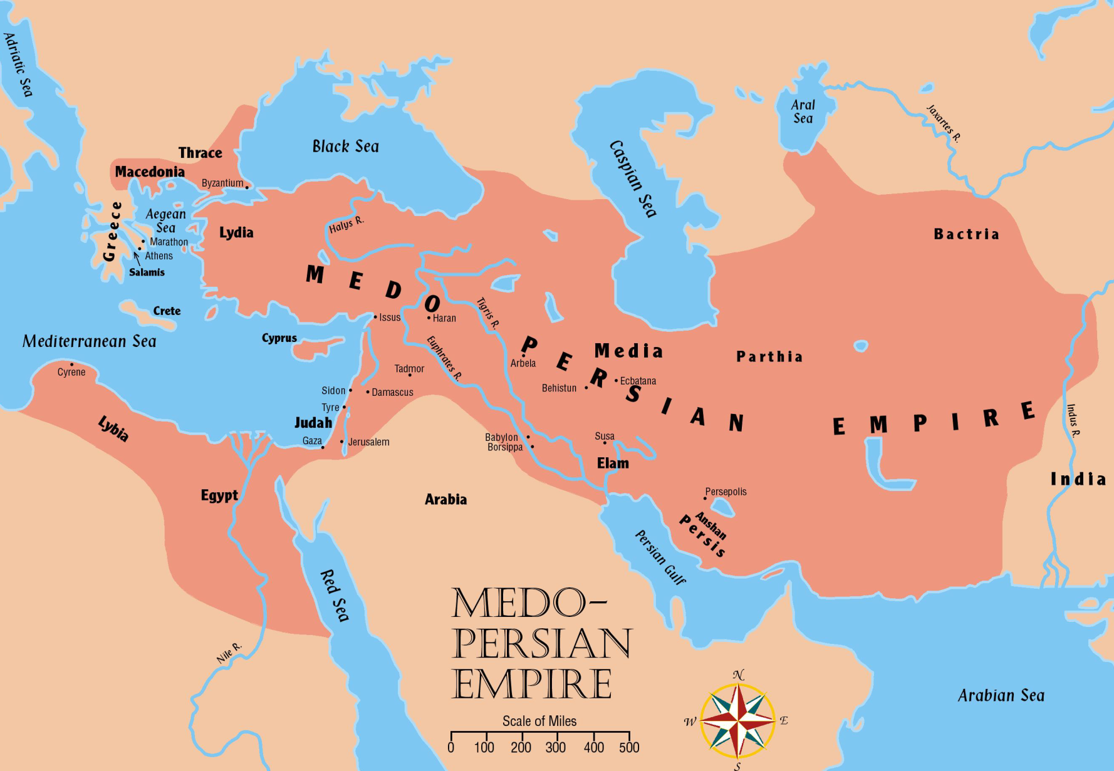
Return Number ONE
Darius conquered new territories
A wise administrator
Initiated many legal and fiscal reforms in the land to promote commerce
Built roads
Established an efficient postal system
Built a canal connecting Gulf of Suez to the Mediterranean Sea

Slide 19

Return Number ONE
Judah was a tiny dependency in an empire of 2,000,000 square miles
  A Persian governor ruled the fifth Satrapy
  Extended from northern Syria down to the border of Egypt
    Called Abarnahara
    “the land beyond
    the Euphrates”

Slide 20
Return Number ONE
When king Darius came to power, Haggai and Zechariah urged the people to resume work
  The people really needed this encouragement

Slide 21
Return Number ONE
  A new letter is sent to the king telling the story of Jerusalem correctly (Ezra 5)
    Darius checked the records and found the original decree from Cyrus in the palace of Achmetha in Media
    He gave orders for the work to be finished and he forbade ANY opposition. (Ezra 6:1-2)
  The temple was finished 20 years after it was begun
    A total of 4 years labor time (515 BC)

